Slide 1
Version Control Software
Step 1: Track code changes
Step 2: ???
Step 3: Profit

Slide 2
Why Do We Need A VCS?
VCSs Track File Changes
Code is organized within a repository.
VCSs Tell Us:
Who made the change?
So you know whom to blame
What has changed (added, removed, moved)?
Changes within a file
Addition, removal, or moving of files/directories
Where is the change applied?
Not just which file, but which version or branch
When was the change made?
Timestamp
Why was the change made?
Commit messages
Basically, the Five W’s

Slide 3
Brief History Of Version Control Software
First Generation – Local Only
SCCS – 1972
Only option for a LONG time
RCS – 1982
For comparison with SCCS, see this 1992 forum link
Second Generation – Centralized
CVS – 1986
Basically a front end for RCS
SVN – 2000
Tried to be a successor to CVS
Perforce – 1995
Proprietary, but very popular for a long time
Second Generation (Cont.)
Team Foundation Server – 2005
Microsoft product, proprietary
Good Visual Studio integration
Third Generation – Decentralized
BitKeeper – 2000
GNU Bazaar – 2005
Canonical/Ubuntu
Mercurial – 2005
Git – 2005
Team Foundation Server – 2013

Slide 4
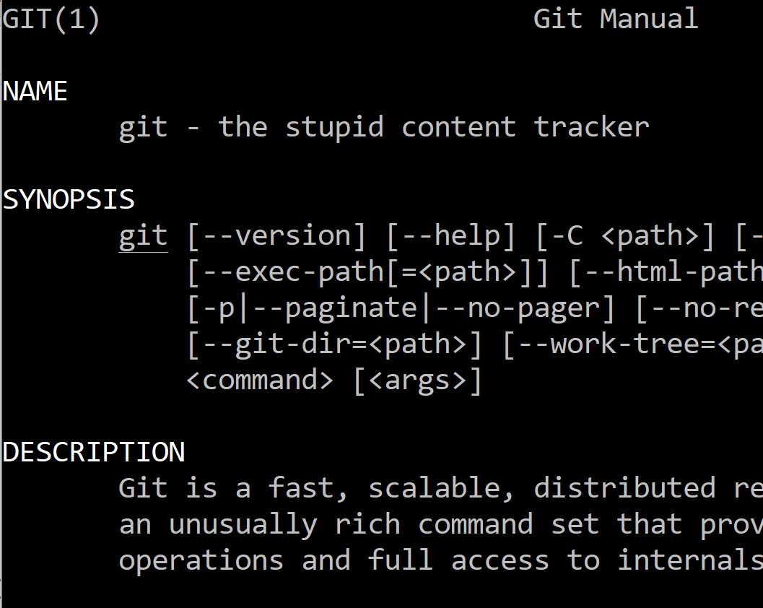
Git – The Stupid Content Tracker
Started by Linus Torvalds – 2005
After the BitKeeper debacle
Efficient for large projects
E.g., Linux
Was an order of magnitude faster than other contemporary solutions
Non-linear development!
Branching is cheap and easy!!!!
Official Site, Wikipedia,
Initial README commit (some profanity)

Slide 5
Terminology
Branch
A history of successive changes to code
A new branch may be created at any time, from any existing commit
May represent versions of code
Version 1.x, 2.x, 3.x, etc.
May Represent small bugfixes/feature development
Branches are cheap
Fast switching
Easy to “merge” into other branches
Easy to create, easy to destroy
See this guide for best practices
Commit
Set of changes to a repository’s files
More on this later
Tag
Represents a single commit
Often human-friendly
Version Numbers
A Repository may be created by:
Cloning an existing one (git clone)
Creating a new one locally (git init)

Slide 6
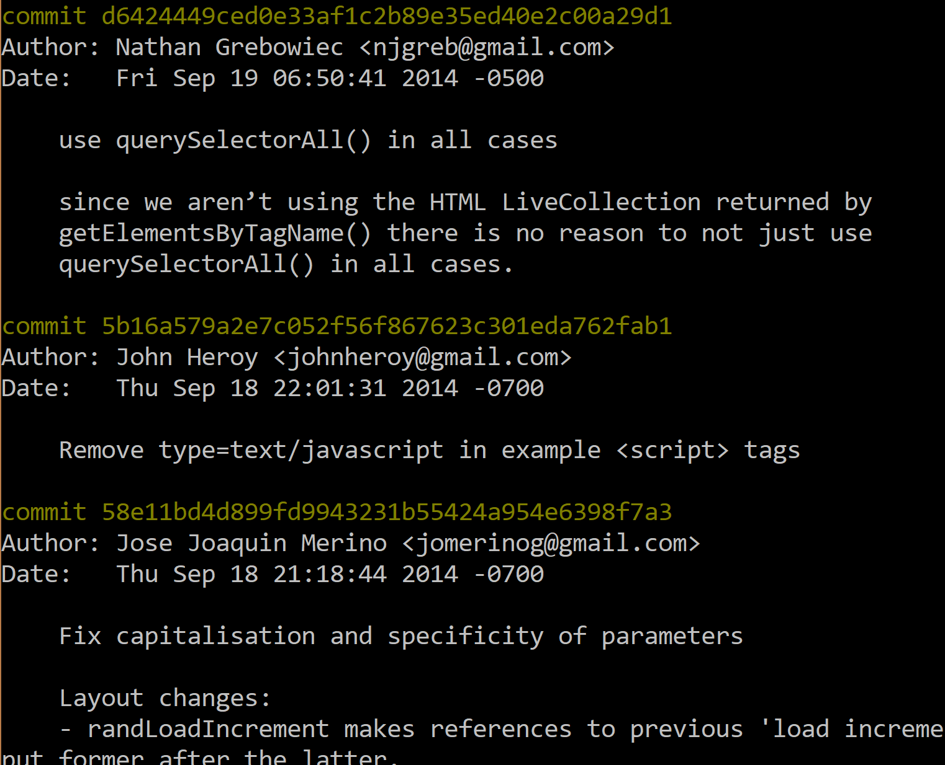
What is a Commit?
Specific snapshot within the development tree
Collection of changes applied to a project’s files
Text changes, File and Directory addition/removal, chmod
Metadata about the change
Identified by a SHA-1 Hash
Can be shortened to approx. 6 characters for CLI use
(e.g., “git show 5b16a5”)
HEAD – most recent commit
ORIG_HEAD – after a merge, the previous HEAD
<commit>~n – the nth commit before <commit>
e.g., 5b16a5~2 or HEAD~5
master@{01-Jan-2018} – last commit on master branch before January 1, 2018

Slide 7
Branches, Commits, and Tags, Oh My!
c4d00a
Add Cool Feature 1
e11bd4
Add Cool Feature 2
9e35ed
Add Cool Feature 3
f1c2b8
Change the API (again)
a2e7c0
Initial Commit
fd9943
Change the API
Master
(branch)
8f645f
Add Stuff
9fd132
Bugfix 1
af1c2b
Bugfix 2
1.x
(branch)
1.0
1.1
619cec
Add Stuff
(tag)
(tag)
2.x
(branch)

Slide 8
Terminology
Working Files
Files that are currently on your File System
The Stage (also called the “index”)
Staging is the first step to creating a commit
The stage is what you use to tell Git which changes to include in the commit
File changes must be “added” to the stage explicitly
Only changes that have been staged will be committed
Checkout
Replace the current working files with those from a specific branch or commit
Use “git diff” to see which changes exist.
Use “git add” to tell Git that a file’s changes should be added to the stage.
Use “git status” to see the changes in your working files, as well as what changes have been staged for the commit.
Use “git commit” to convert all staged changes into a commit.
git commit -m “my commit message”
git commit -m “my commit message” -a
Will automatically stage all files tracked by the repo & add them to the commit.
Please don’t do this.

Slide 9
A Distributed VCS
What do we mean by distributed?
Cloning a repository (repo) creates a full copy of that repo on your local machine.
You can fetch updates from non-local repositories (e.g., repos on GitHub)
A non-local repositories is a remote
When you clone a repository, a remote called origin is created for you automatically in your local repo which points to the source repo.
Remotes are local settings. They do not become part of your commits.
You may set up additional remotes.
Use case: Development teams, where each dev has their own repository.
Common Pattern:
One canonical repository for the project (on GitHub, for example)
Every developer forks that repo on GitHub
A fork is simply creating a copy of the repo on that remote system
Every developer clones their own GitHub repo to their local machine
Every developer adds a remote pointing to the canonical (main, authoritative) repo, as well as other dev repos as needed
Devs work locally, push changes to their own remote, then request that the canonical repo accept their changes via a pull request.

Slide 10
A Distributed VCS (Visualized)
GitHub, BitBucket, SourceForge, GitLab, CodePlex, etc.
Pull Request
Canonical
fork
fork
fork
Arlene
Cindy
Bret
main
clone
origin
bret
cindy
Action
Local repo
Remote (no push)
Remote (with push)
Action on GitHub
*Names taken from 2017 Tropical Storms

Slide 11
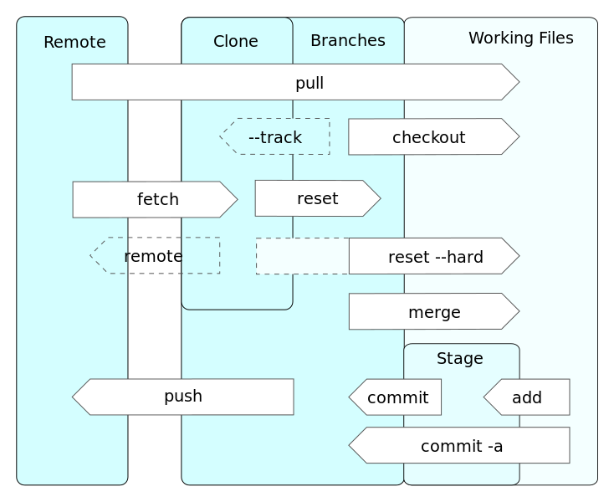
Git Workflow
Local
You pull from a remote to your local repository.
A pull is a fetch and a merge
I prefer to use fetch and merge separately, and avoid pull.
You push a branch from your local repository to a remote.
A failure to merge is a merge conflict, and must be resolved manually. (more on next slide)
Helpful list of Git Commands
https://cscrunch.com/blog/corey-pennycuff/my-git-cheat-sheethandout
Image by Daniel Kinzler

Slide 12
Merging
A “merge” is the act of incorporating the changes from one branch or commit into a second branch.
The histories do not have to match exactly; Git will work to sort them out.
If a merge fails, Git will notify you of a “merge conflict”.
Merge conflicts must be fixed manually, and then added and committed.
“git status” will show any merge conflicts.
A successful merge creates a new commit automatically.
What causes a merge conflict?
2 branches modify the same place in the same file.
This often happens at the end of files or between function declarations.
Git does not know which version of the change you want, or if you want both of them consecutively (and in which order), so you must inspect the conflict and resolve it.
If you cannot push your code to a remote, you probably need to first pull the latest changes, resolve any existing merge conflicts, then try to push again.
Small commits are better than large ones!

Slide 13
Common Industry Programmer Workflow
Choose a bug/feature to work on
Checkout the appropriate branch
Pull the latest additions from the main repository
Create a branch for the bug/feature request
Do the coding necessary & commit
Push the changes to your remote
Create a pull request to main repo
The pull request is where other programmers review your code & make comments/suggestions.
If changes are needed to your code, then repeat the process.
Never commit directly to the main repo.

Slide 14
Practical Guidelines
Do’s
Make small, incremental commits (within reason) are good. Avoid monolithic commits at all cost.
Use a separate branch for each new bug/feature request.
Write nice commit messages. Otherwise, the commit log is useless.
Use a .gitignore to keep cruft out of your repo.
Search engines are your friend. Someone else has had the same question/mistake/situation as you, and they have already asked the question online. It’s probably on StackOverflow.
Don’ts
Do not commit commented-out debug code.
It’s messy. It’s ugly. It’s unprofessional.
Do not mix your commits. (e.g., Don’t commit two bugfixes at the same time.)
Do not commit sensitive information (passwords, database dumps, etc.)
Do not commit whitespace differences, unless it is specifically needed.
Do not commit large binaries.

Slide 15

Helpful Resources
Pro Git – free Apress ebook
Visualizing Git histories
Wikipedia on Version Control, with definitions
My Git Cheat Sheet
Git Commit Etiquette for Junior Devs
https://www.codeschool.com/learn/git
Free course to walk you through basic Git concepts

